Slide 1
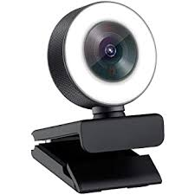
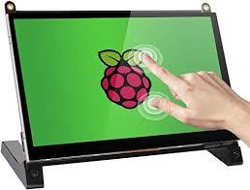
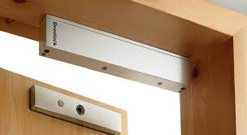
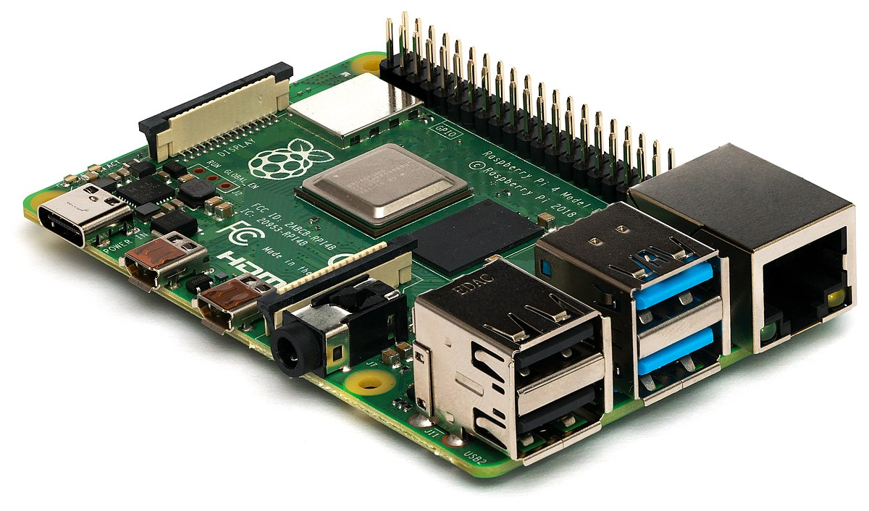
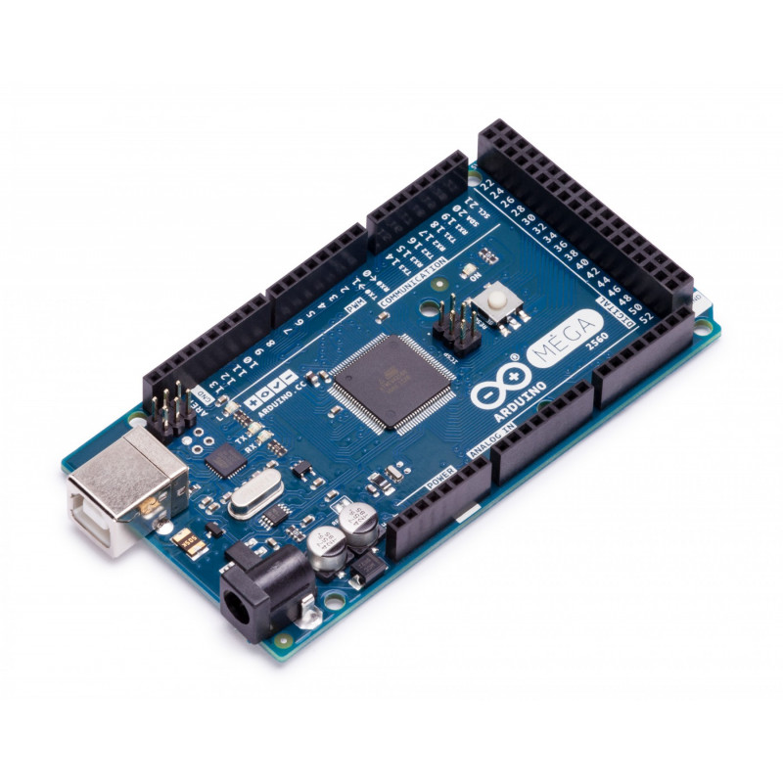
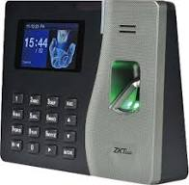
Door Lock
Camera to capture faces
Touch Screen
Finger Print reader
Main server contains the Face recognition system , database control program and user interface
Record users , faces , data , generate report
Access Control Board (receive open signal from the server and send it the Door lock, also receive signals from the finger print reader

